Slide 1
Coordinate Geometry

Slide 2
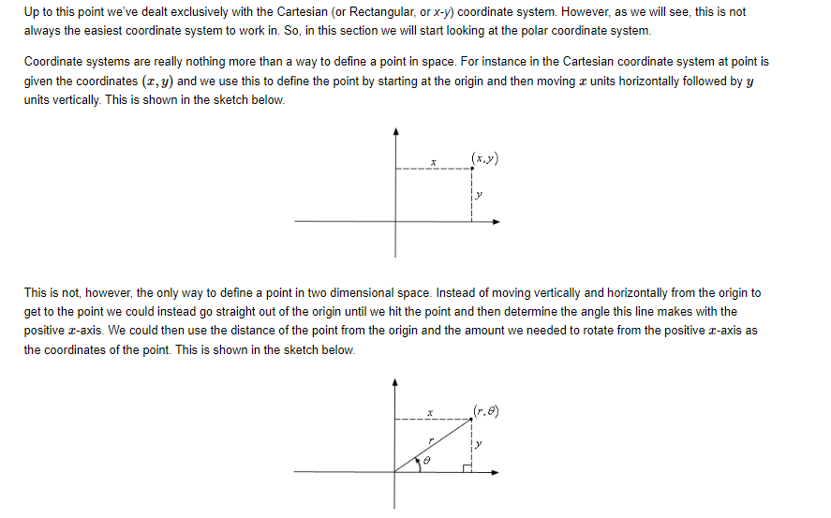

Polar Coordinate

Slide 3
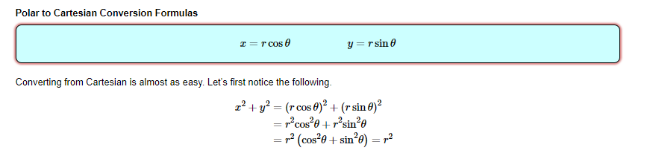
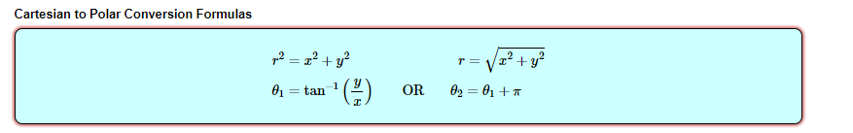
Coordinate conversions

Slide 4
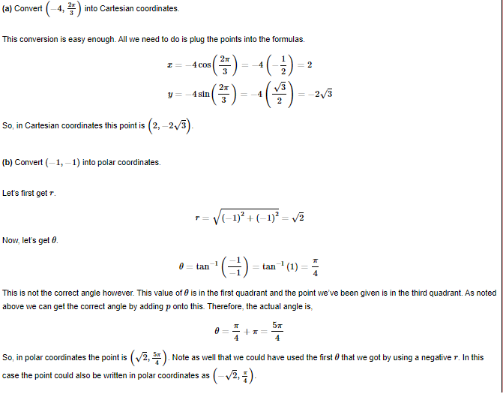
Coordinate Conversion Example

Slide 5
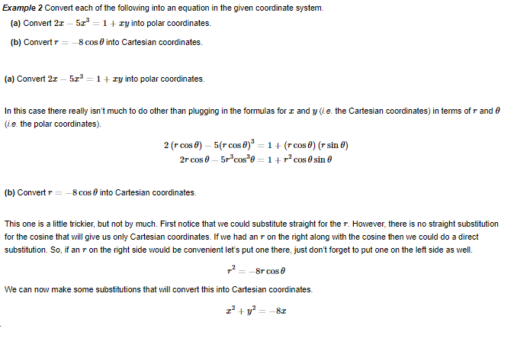
Equation Conversion Examples

Slide 6
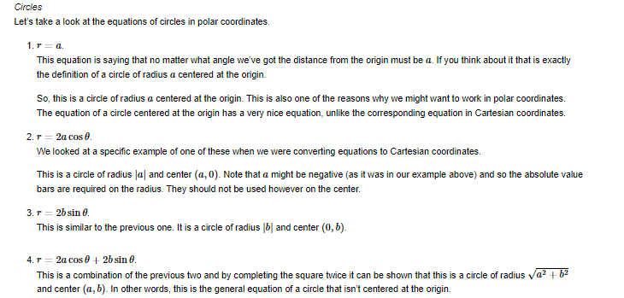
Circles in Polar coordinates

Slide 7
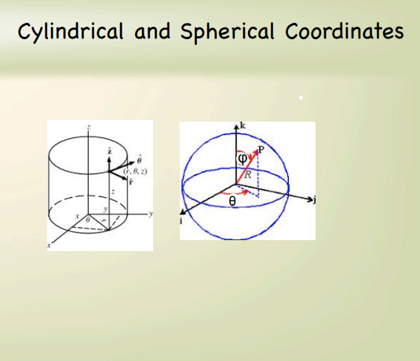

Slide 8
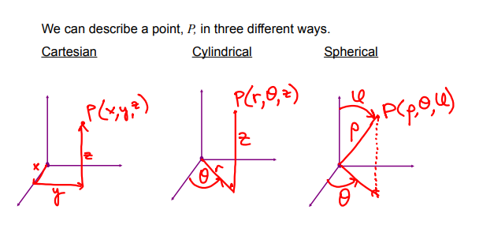

Slide 9
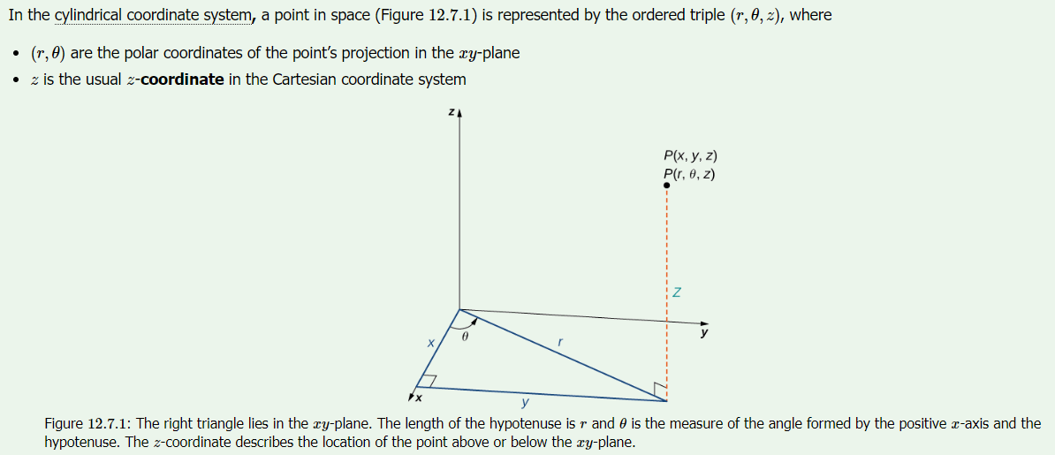
Cylindrical coordinate system

Slide 10
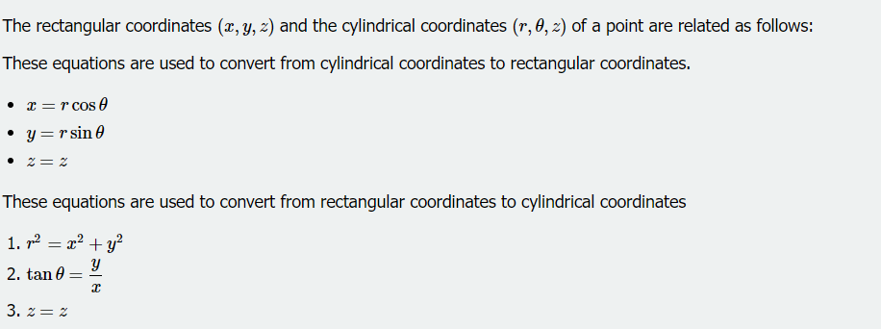
Equations of conversion

Slide 11
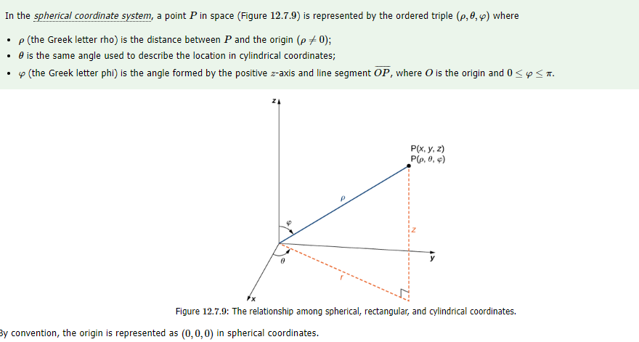
Spherical coordinate system

Slide 12
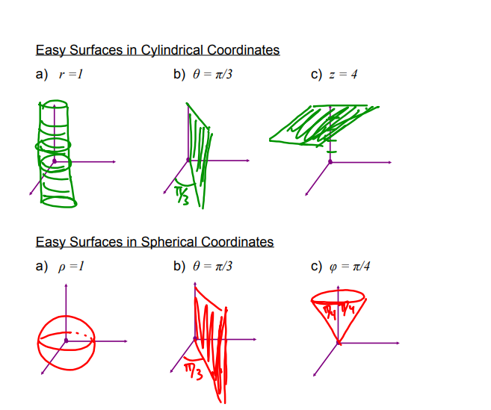
Cylindrical coordinate surfaces

Slide 13
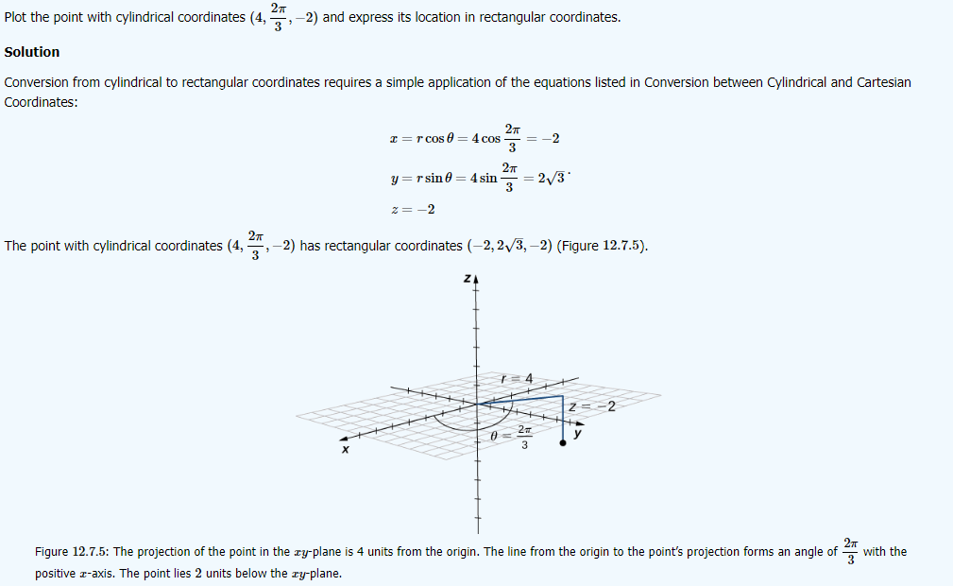
Cylindrical to rectangular conversion

Slide 14
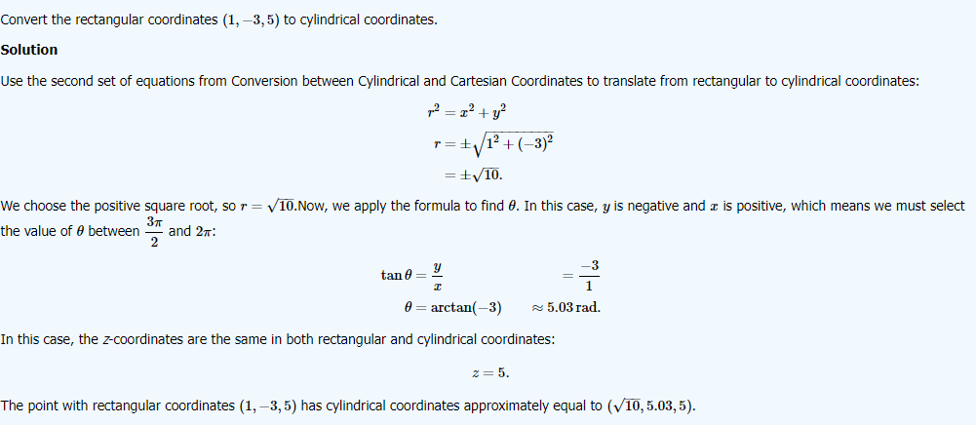
Rectangular to cylindrical conversion

Slide 15
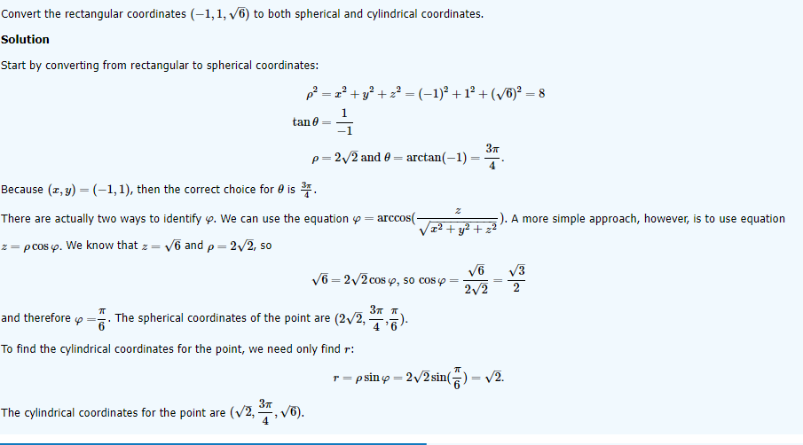
Rectangular to spherical and cylindrical conversion

Slide 16
Coordinate Conversion Practice Problems

Slide 17
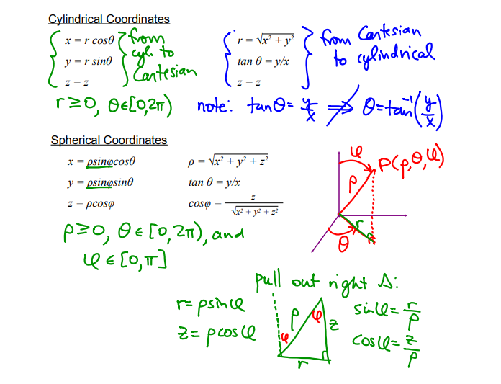

Slide 18
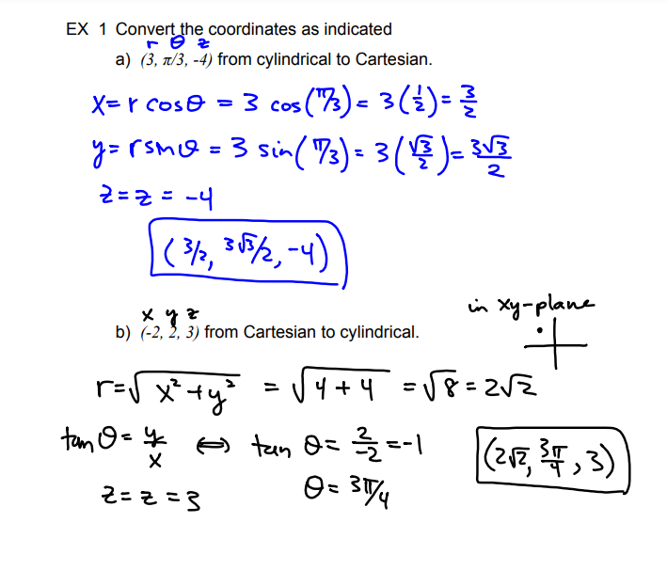

Slide 19
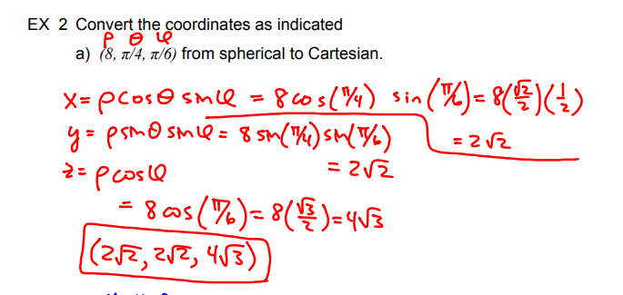

Slide 20
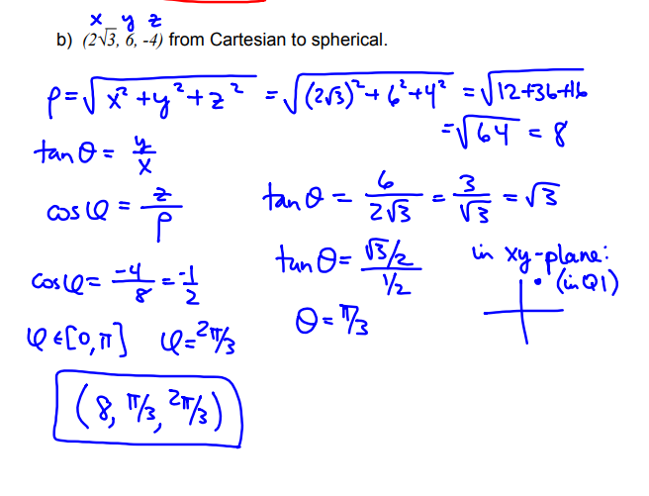

Slide 21
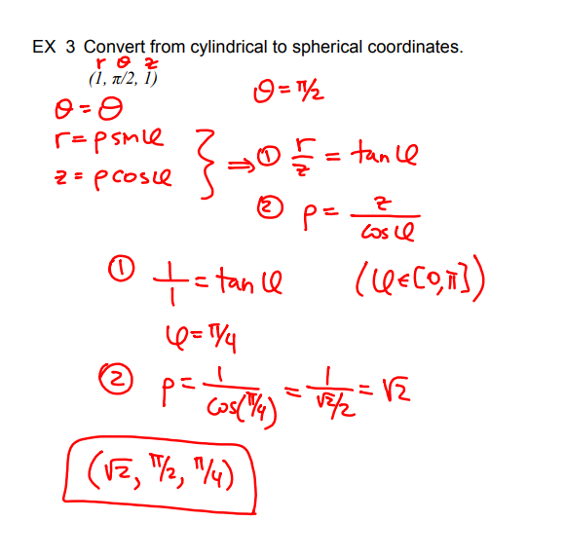

Slide 22
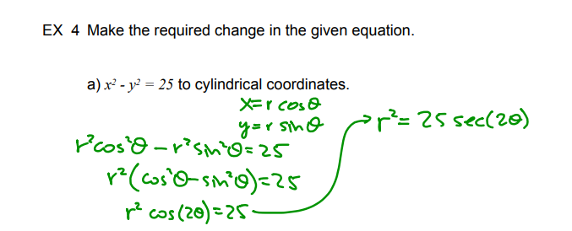
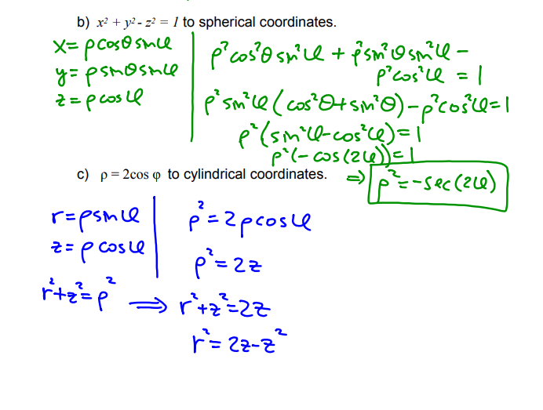

Slide 23
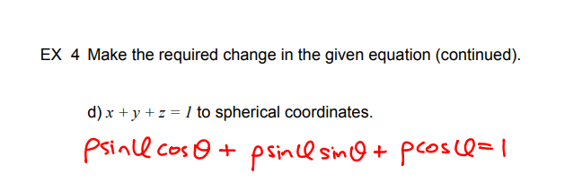
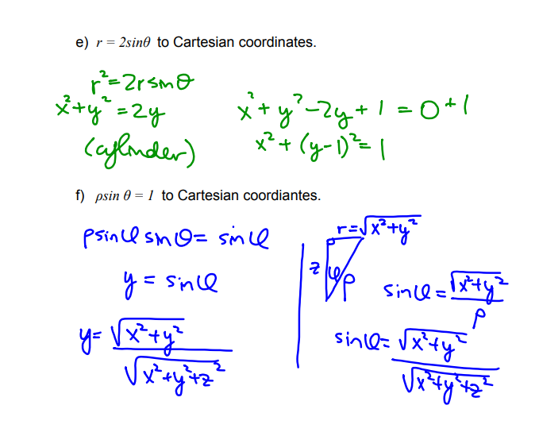

Slide 24
PRACTICE SUMS FROM HOWARD ANTON 10th Edition Page-837, Exercise: 11.8

Slide 25
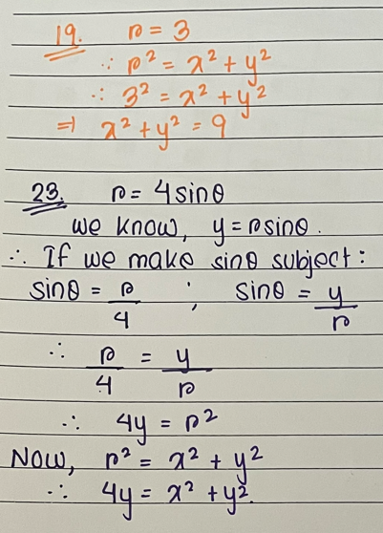
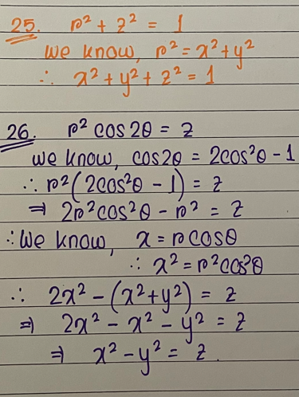
Express the equations in cylindrical coordinates as equations in rectangular coordinates

Slide 26
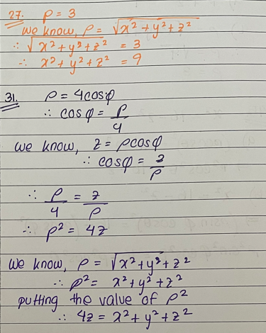
Express the equations in spherical coordinates as equations in rectangular coordinates

Slide 27
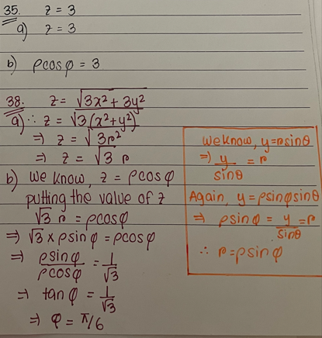
Express the equations in rectangular coordinates as equations in (a) Cylindrical coordinates (b) Spherical coordinates

Slide 28
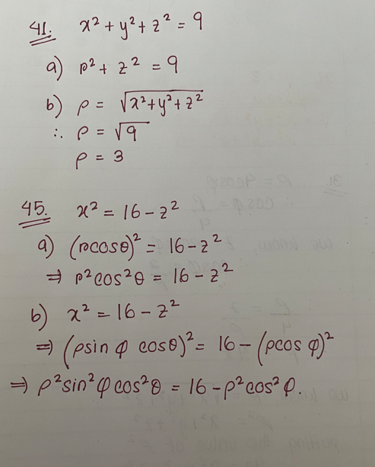
Express the equations in rectangular coordinates as equations in (a) Cylindrical coordinates (b) Spherical coordinates

Slide 29
Spherical Equation Surface Sums

Slide 30
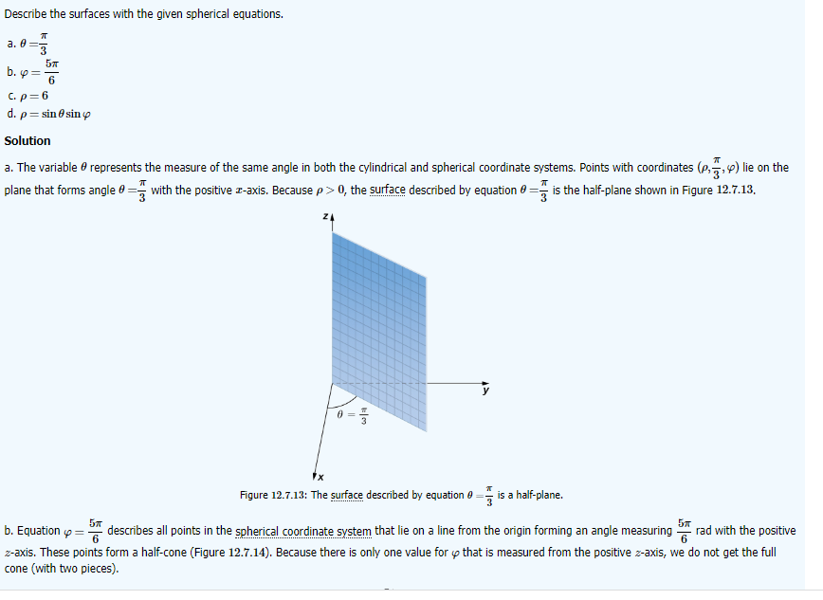

Slide 31
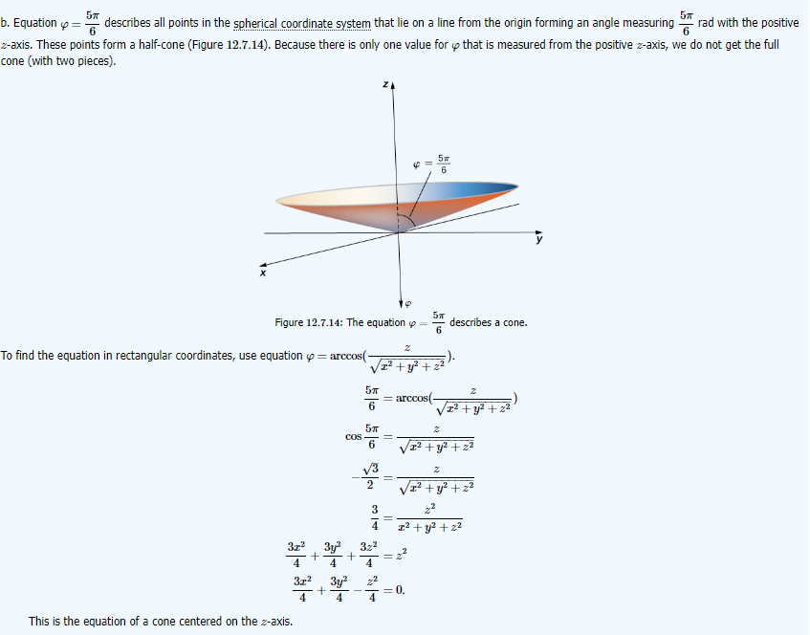

Slide 32
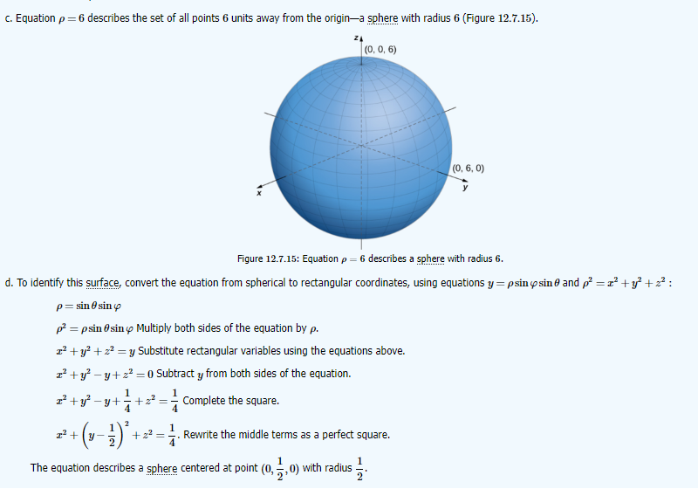

Slide 33
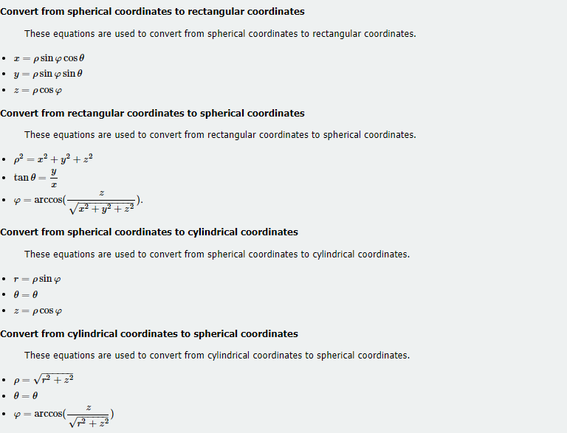
Summary

